Slide 1

Team: Designers

Slide 2

Lack of Reading Habit Among Students
In today’s world, children are increasingly spending more time on digital devices and less time reading books. This has led to a decline in reading habits affecting:
Language development
Concentration
Imagination
Vocabulary
Overall learning ability.
Therefore, there is a need to explore effective ways to encourage and develop regular reading habits among children so that they can improve their knowledge, creativity and academic performance.

Slide 3
Problem Description
To address the declining reading habits among students caused by increased screen time and digital distractions.
Many students prefer spending their free time on mobile phones, television or social media rather than reading books.
Lack of access to engaging reading spaces and interesting books reduces students’ motivation to read.
As a result, students show limited vocabulary development, weaker comprehension skills and reduced creativity.

Slide 4
Requirements and Specifications
Sample size: 100 students
Participants: Students from Grade 4 and Grade 6
Survey / Questionnaire: To be completed by students and parents
Library Data: Analysis of book borrowing and reading habits/types of books read
Access to Devices and Books for Reading
Gamification strategies to make reading engaging
Reading Tracker Chart to monitor student progress
Recognition and Rewards
Reader of the Month
Reader of the Year
Reading Corner in different areas of the school
Reading Spark Activities – short, fun reading activities to spark interest

Slide 5
Solution Model
Gamified Reading Program – Introduce reading challenges, badges, and points to motivate students.
Reading Corners in School – Create comfortable reading spaces with attractive and age-appropriate books.
Reading Tracker System – Maintain a tracker chart to monitor the number of books read by students.
Monthly Reading Activities (Reading Spark Sessions) – Storytelling, book talks, and peer reading sessions to make reading enjoyable.
Use of Digital Tools – Encourage reading through e-books, audiobooks, and educational reading apps.
Recognition and Rewards – Introduce titles like Reader of the Month and Reader of the Year.
Expected Outcomes
Increased interest and participation in reading activities.
Improvement in vocabulary and comprehension skills.
Better concentration and imagination among students.
Development of regular reading habits.
Improved academic performance and communication skills.
Creation of a reading culture within the school environment.

Slide 6
AI Tools
Reading Initiative | Suggested AI / Digital Tools | Purpose / Use
Gamified Reading Program (reading challenges, badges, points) | ClassDojo, Kahoot!, Blooket | Create reading challenges, quizzes, reward points, and badges to motivate students.
Reading Corners in School | Canva, ChatGPT | Design posters, book recommendation charts, and generate book summaries or discussion questions.
Reading Tracker System | Google Sheets, Notion | Maintain a digital reading log to track books read, reading progress, and participation.
Monthly Reading Activities (Reading Spark Sessions) | Padlet, Mentimeter | Students share book reviews, reflections, storytelling, and participate in interactive reading discussions.
Use of Digital Reading Tools | Epic!, Audible, StoryWeaver | Provide access to e-books, audiobooks, and multilingual storybooks to encourage reading.
Recognition and Rewards | Canva | Create digital certificates, leaderboards, and announce “Reader of the Month/Year.”

Slide 7
Phase I- Scope-Boundary
Stage | Tool | Outcome | Metrics
Stage-1 Brainstorming | Group discussion/ Survey Challenges: Lack of attention span Devices used for gaming, chatting, etc. Lack of motivation to enhance interests Non appealing nature of books Lack of any time accessibility to the library. Lack of exchange of ideas about the books read to promote reading. Social environment is changing | Increase the reading habit among children by 10% Improvement in vocabulary and comprehension. Students actively discussing books with peers. A positive reading culture developed in the classroom. | The problem is restated well with insights and outputs are presented thoughtfully.

Slide 8
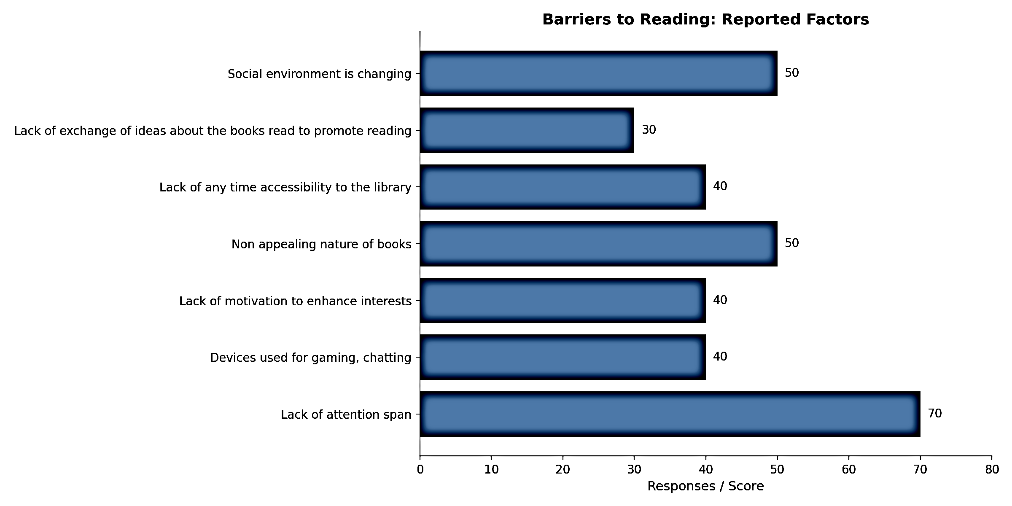
Phase-I (Scope-Boundary)
Stage | Tool | Outcome | Metrics
Stage-2 Idea Posting | Graphical representation of the survey conducted. | Abstract: Data Collected from the Library.

Slide 9
Phase II Empathize
Stage | Tool | Outcome | Metrics
Stage-III Customer Mapping | 1.Peer Interview 2.Group discussion 3. Survey/ Questionnaire- For students 4.Survey/ Questionnaire- For parents 5. Interview of Librarian | Requirement specification from customer specification

Slide 10
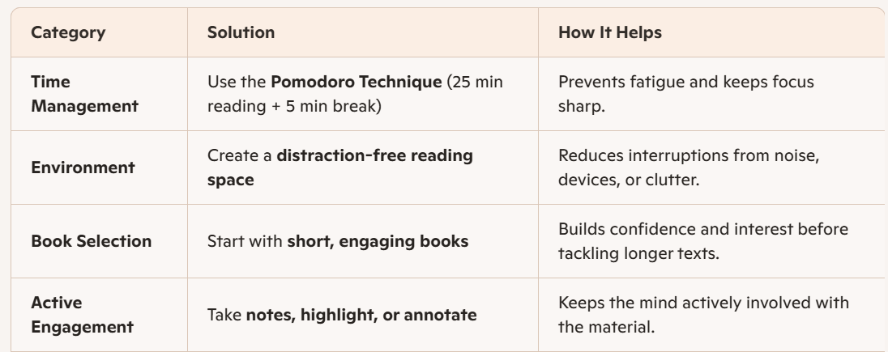
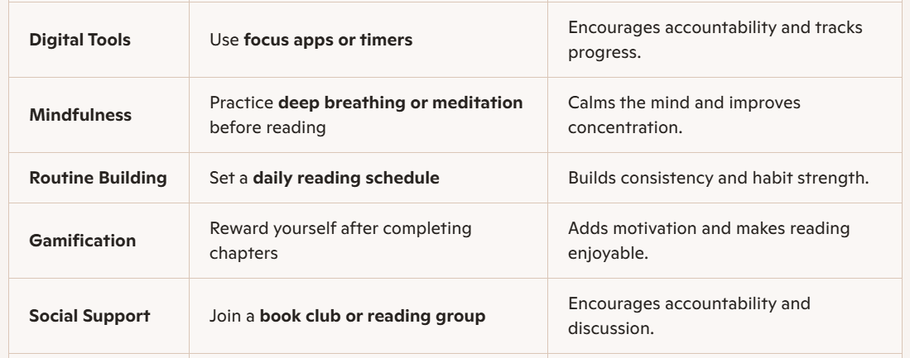
Phase III Define (Insight)
Stage | Tool | Outcome | Metrics
Stage-IV Idea Layout: The analysed problem is mapped with solutions with indicated result outcomes. | Project Chart | An overview of the solution | Solutions are practical, realistic, and directly address the identified problems. Information is clearly organised in a neat problem–solution format.

Slide 11
Phase IV Ideate
Stage | Tool | Outcome | Metrics
Stage-V Reflection: | SCAMPER Technique Modify existing reading strategies (e.g., combine audio + text, adapt reading into games). Checklist (student attention checklist, reading focus tracker), reading trackers are implemented to improve students’ attention span and engagement with texts. | GAPS FIXING The identified strategies after checklist are: • Short focused reading sessions (10–15 minutes) • Distraction-free reading corner • Reading timer and focus tracker. Interactive discussion after reading | Innovative modification of reading strategies (e.g., audio + text, game-based reading) clearly applied. Checklist is well-designed and regularly used to track student attention during reading sessions. Reading focus tracker clearly records duration, engagement, and improvement in attention.

Slide 12
Phase IV Ideate
Stage | Tool | Outcome | Metrics
Stage VI – Design of Modules | Attention Improvement Reading Model 1. Conceptual design – Short focused reading sessions (10–15 minutes) 2. Component level – Reading timer, engaging short texts, reading tracker 3. System / block level – Reading Corner + Focused Reading Activity + Reflection discussion 4. Interfaces & standards – Student participation guidelines and distraction-free reading environment | Block Diagram / Concept Model showing the process of improving students’ attention span during reading. Students practice focused reading for short durations. Gradual improvement in concentration and engagement with texts. | Duration students remain focused while reading Number of students participating Improvement in comprehension responses after reading

Slide 13
Phase IV Ideate
Stage | Tool | Outcome | Metrics
Stage VII – Resources Identification | Requirements Specification 1. Reading Corner space in the classroom or library 2. Short engaging reading materials (story books, magazines, short articles) 3. Reading timer or focus timer (10–15 minute sessions) 4. Reading tracker / log sheet 5. Sticky notes for reflections 6. Student feedback forms 7. Posters encouraging focused reading 8. Book exchange register 9. Teacher facilitation and monitoring | Resources for Implementation Materials: Books, magazines, reading charts, timers Tools: Reading tracker, feedback forms, reflection sheets Support: Classroom reading corner and peer discussion sessions Output: Structured environment that helps students improve their attention span while reading | Reading corner is well organized, attractive, and easily accessible to students. Wide variety of engaging materials such as storybooks, magazines, and articles are available. Reading timer is consistently used to conduct structured reading sessions (10–15 minutes).

Slide 14
Phase IV Ideate
Stage | Tool | Outcome | Metrics
Stage VIII– Planning | Project Execution Schedule • Week 1 – Conduct survey on students’ attention span during reading • Week 2 – Set up a distraction-free reading corner • Week 3 – Introduce short focused reading sessions (10–15 minutes) • Week 4 – Use reading tracker and reflection notes • Week 5 – Collect feedback and analyse improvement | Risk Students may lose interest quickly Limited reading resources Constraints Limited time during school hours Different reading levels among students Assumptions Students will participate in reading activities Teachers will support monitoring and guidance | Do

Slide 15
Phase IV Ideate
Stage | Tool | Outcome | Metrics
Stage IX– Re-Design | Checklist against Requirement Specifications from Student Feedback Mapping • Review reading session duration • Check student engagement levels • Analyse feedback from reading tracker • Identify distractions affecting attention | Improved Reading Strategy is included and updated in the reading programme • Shorter reading sessions (10–15 minutes) • Interactive discussion after reading • Use of engaging and age-appropriate reading material • Better arrangement of the reading corner to minimise distractions | Reading duration is regularly recorded and clearly analysed to understand attention patterns. Student feedback is collected, analysed, and used to improve reading activities. Distractions are clearly identified and practical solutions are suggested.

Slide 16
Phase V Prototype
Stage | Tool | Outcome | Metrics
Stage X– Execution Framework | Focused Modules Overall System – Reading Attention Improvement Model Reading Activity Dashboard ▪ Reading session duration tracker ▪ Student participation status ▪ Number of books/articles read ▪ Focus improvement observation Structured Reading Activity Plan (short focused reading sessions) | Requirements for the Focused Modules Implementation of: • Reading corner for distraction-free environment • Short timed reading sessions (10–15 minutes) • Reading tracker / reflection sheets | * Alignment of activities with reading objectives Clarity and usability of the micromodule design Evidence of improvement in simulated engagement data

Slide 17
Phase V Prototype
Stage | Tool | Outcome | Metrics
Stage XI- Micromodule | Develop a mind map to organise the reading strategy micromodule content. • Identify key reading skills (skimming, scanning, vocabulary inference) • Structure the micromodule into short learning segments (10–15 minutes) • Map activities like guided reading, discussion and reflection • Connect reading goals with student engagement strategies | Prototype of the reading strategy micromodule is created and tested using simulated classroom data. * Sample student responses collected * Engagement levels estimated through simulated scenarios Effectiveness of short reading sessions analysed Feedback used to refine the micromodule | Clear and well-organized model explaining how the reading improvement system works. Reading time is accurately tracked and well presented.

Slide 18
Phase V Prototype
Stage | Tool | Outcome | Metrics
Stage XII -Execution Process flow | Flowchart Identify the sequence of activities in the reading programme implementation Show steps such as reading session planning, activity execution and reflection Map teacher and student roles during the reading session Outline the process for recording engagement and participation data | Outcome Data Visualization of the implementation process. Representation of reading session workflow Graphs or charts showing student participation and engagement Visual comparison of reading duration and attention levels Identification of stages where improvement is required | * Clarity of the process flow Logical sequencing of steps Accuracy of data representation Ease of interpretation of the visual data

Slide 19
Phase VI Validate
Stage | Tool | Outcome | Metrics
Stage XIII Testing | Mapping* Map the overall reading programme system* Map teacher guidance and classroom management processes* Track student reading behaviour and participation* Identify patterns in engagement and comprehension | * Improved student focus during reading sessions* Increased participation in post-reading discussions* Better comprehension and vocabulary development* Reduced distractions during reading time | * Improvement in student engagement levels* Feedback from students and teachers* Observed changes in reading habits* Consistency of results during trial sessions

Slide 20
Phase VII Implementation
Stage | Tool | Outcome | Metrics
Stage XIV Implement | Implementation Summary & Inference Report* Summarise the reading strategy implementation process* Document observations from classroom application* Compile teacher reflections and student feedback* Identify best practices for future improvement | Cost Estimate Details and Benefits of the reading programme.* Time and resource requirements for implementation* Benefits in terms of improved reading engagement* Development of better comprehension and vocabulary skills* Long-term improvement in students’ reading habits | * Evidence of improved reading outcomes* Teacher and student satisfaction* Feasibility of continuing the programme* Sustainability and scalability of the strategy

Slide 21
Phase VIII Report
Stage | Tool | Outcome | Metrics
Stage XV Retrospective | https://bkbirlaschoolkalyan-my.sharepoint.com/:w:/g/personal/amrita_chandorkar_birlaschoolkalyan_com/IQAfRHkB8B_qT763mFuBUd3JAbS2MEQ9s2FkrAadgx0PJWY?e=CsXJFF

Slide 22


